Slide 1
主要内容 Main Content
机泵知识 Pump knowledge
操作要求 Operation requirement
日常巡检 Daily inspection
故障分析 Failure analysis

Slide 2
离心泵的定义及优缺点 Centrifugal Pump Definition, Pros & Cons
定义:离心泵是根据离心力原理设计的，即高速旋转的叶片带动介质转动，从而将介质甩 出以达到输送目的的一类动设备。
Definition: A centrifugal pump is a type of dynamic equipment designed based on the principle of centrifugal force. The high-speed rotating blades drive the medium to rotate, thereby throwing the medium out to achieve the purpose of transportation.
优点:离心泵具有结构简单、体积小、质量轻、流量稳定、易于制造和便于维护等一系列
优点。
Pros: A centrifugal pump has several advantages, including a simple structure, compact size, lightweight, stable flow rate, ease of manufacturing, and convenient maintenance.
缺点:离心泵对高粘度液体以及流量小、压力高的情况适用性较差，并且在通常情况下启
动之前需先灌泵。
Cons: Centrifugal pumps are less suitable for high-viscosity liquids and conditions requiring low flow rates and high pressure. Also, they usually need to be primed before starting.

Slide 3
离心泵的分类 Classification of Centrifugal Pumps
按叶轮数目: 可分为单级泵和多级泵;
Numbers of impellers: Single-stage pumps and multi-stage pumps;
按叶轮进液方式:可分为单吸式和双吸式;
Methods of liquid entering the impeller: Single-suction and double-suction types;
1.单吸式泵--液体从一侧进入叶轮。
Single-suction pump—The liquid enters the impeller from one side.
2.双吸式泵--液体从两侧进入叶轮。多见于大流量离心泵，一般说来其吸入性能较好。
Double-suction pump—The liquid enters the impeller from both sides. It is commonly seen in large flow centrifugal pumps, and generally has better suction performance.

Slide 4
离心泵的分类 Classification of Centrifugal Pumps
按泵壳剖分形式:可分为水平剖分泵和垂直剖分泵;
Split form of pump casing: Horizontal split pumps and vertical split pumps;
按泵型分为: 悬臂式、两端支撑式、立式悬吊式三类。
Pump type: Cantilever type, both-end supported type, and vertical suspension type.
悬臂式: OH1~OH6泵型;
Cantilever type: OH1~OH6 pump models;
两端支撑式: BB1~BB5泵型;
Both-end supported type: BB1~BB5 pump models;
立式悬吊式: VS1~VS7泵型;
Vertical suspension type: VS1~VS7 pump models;

Slide 5
离心泵的分类 Classification of Centrifugal Pumps
按泵轴的转速分:一般分为普通泵和高速泵;(高于10000转/分为高速泵)。
Speed of pump shaft: Generally divided into ordinary pumps and high-speed pumps (above 10000 RPM is considered a high-speed pump)
按泵轴的位置分:一般分为卧式泵和立式泵。
Position of pump shaft: Generally divided into horizontal pumps and vertical pumps.
按泵扬程的大小:分为低压泵( 扬程小于20米水柱)、中压泵(20~160 米水柱)和高压泵( 高于160米
水柱)。
Size of pump head: Divided into low-pressure pumps (size less than 20 meters of water columns), medium-pressure pumps (20~160 meters of water columns), and high-pressure pumps (above 160 meters of water columns)
按输送介质和用途分:水泵、油泵、酸泵、碱泵、锅炉给水泵、冷凝水泵等。
Conveyed medium and its use: water pumps, oil pumps, acid pumps, alkali pumps, boiler feed pumps, condensate pumps, etc.
按泵轴的支承方式分:一般分为悬臂泵和双支承泵。
Support method of pump shaft: Generally divided into cantilever pumps and double-support pumps

Slide 6
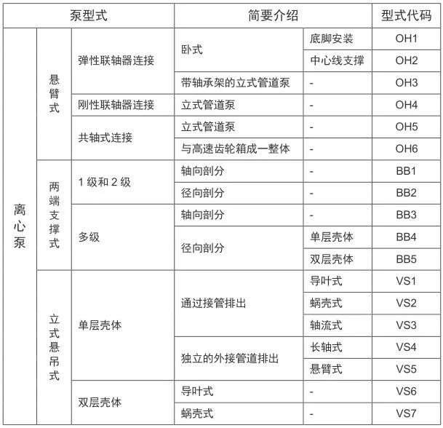
机泵分类

Slide 7
Pump Classification
Pump Type |  |  | Brief Introduction |  | Model Code
CENTRIFUGAL PUMP | Cantilever | Flexible coupling connection | Horizontal | Foot mounted | OH1
 |  |  |  | Centerline Supported | OH2
 |  |  | Vertical pipeline pump with shaft bearing | - | OH3
 |  | Rigid coupling connection | Vertical pipeline pump | - | OH4
 |  | Coaxial connection | Vertical pipeline pump | - | OH5
 |  |  | Integral with high-speed gearbox | - | OH6
 | Two-End Support | Stage 1 and Stage 2 | Axial split | - | BB1
 |  |  | Radial split | - | BB2
 |  | Multistage | Axial split | - | BB3
 |  |  | Radial split | Single Casing | BB4
 |  |  |  | Double Casing | BB5
 | Vertical Suspended | Single shell | Discharge through pipe | Guide Vane type | VS1
 |  |  |  | Volute type | VS2
 |  |  |  | Axial flow type | VS3
 |  |  | Independent external pipe discharge | Long shaft type | VS3
 |  |  |  | Volute type | VS5
 |  | Double shell | Guide vane type | - | VS6
 |  |  | Volute type | - | VS7

Slide 8
泵装置的组成 Composition of pump device
进出口管路系统包括吸入管路、吸入阀、排出阀、止回阀和排出管路等。对于离心泵以吸上方式 输液时，还需配用灌泵的管路和底阀( 止回阀) 等。
The inlet and outlet piping system includes the suction pipeline, suction valve, discharge valve, check valve, and discharge pipeline, etc. For centrifugal pumps that transport liquid via suction, it is also necessary to equip the pipeline for priming and a foot valve (check valve), etc.
动力和传动系统包括原动机( 一般为电动机或汽轮机)、变速器( 增速器或减速器)。当泵需要以改变 泵速进行调节时，还需配用调速器，以及供电、供汽系统。
The power and transmission system includes the prime mover (generally an electric motor or turbine), and the gearbox (speed increaser or reducer). When the pump needs to be adjusted by changing the pump speed, a speed controller, as well as power supply and steam supply systems, are also required.
密封系统 主要为轴封的冲洗液、润滑液、冷却液、密封液等液体的注入和循环的管路、贮液罐和 泵等。
The sealing system primarily includes the pipelines, liquid storage tanks, and pumps for the injection and circulation of fluids such as seal flushing liquid, lubricating liquid, cooling liquid, and sealing liquid.

Slide 9
泵装置的组成 Composition of pump device
润滑系统 为泵轴承供给润滑油的油杯、油泵、管路、过滤器、冷却器、液位计等。
The lubrication system includes the oil cups, oil pumps, pipelines, filters, coolers, and level gauges that supply lubricating oil to the pump bearings.
临测和自控系统包括泵的流量、压力、温度(轴承温度、泵壳体温度、电机绕组温度)、振动、转 速、功率等运行参数的显示和自动控制的仪表、仪器和执行机构等，及其供电、供气系统。
The monitoring and automatic control system includes instruments, meters, and actuators for displaying and automatically controlling operational parameters such as the pump’s flow, pressure, temperature (bearing temperature, pump casing temperature, motor winding temperature), vibration, speed, and power, as well as their power supply and air supply system.

Slide 10
离心泵特性曲线 Centrifugal pump characteristic curve
离心泵特性曲线表示离心泵各特性参数[包括流量Q、扬程H、效率n、输入功率( 轴功率P 及必需 的汽蚀余量NPSHR 等] 之间的关系。特性曲线由泵性能试验得到，一般是以常温清水进行试验， 并换算到泵额定转速下的参数值，绘制成泵特性曲线。在应用离心泵时,如果使用条件(主要是被 送液体的性质) 不同,应对泵的特性参数进行换算。
Centrifugal pump characteristic curve represents the relationship between various characteristic parameters of the centrifugal pump, including flow rate (Q), head (H), efficiency (η), input power (shaft power P), and required NPSH (Net Positive Suction Head, NPSHR), etc. The characteristic curve is obtained through pump performance testing, typically conducted with clean water at ambient temperature, and the parameters are then converted to values at the pump’s rated speed to plot the pump characteristic curve. When applying a centrifugal pump, if the operating conditions (mainly the properties of the fluid being pumped) are different, the pump’s characteristic parameters should be adjusted accordingly.

Slide 11
离心泵特性曲线 Centrifugal pump characteristic curve
根据离心泵的特性曲线可选用满足需要的离心泵。如离心泵的流量-扬程(Q-H)曲线，一般分为平 坦形、陡降形和驼峰形三种。
According to the characteristic curve of a centrifugal pump, a pump that meets the requirements can be selected. For example, the flow-head (Q-H) curve of a centrifugal pump is generally divided into three types: flat, steep drop, and hump-shaped curves.
泵应具有至关死点为止连续上升无驼峰的稳定流量- 扬程曲线。
The pump should have a stable flow-head curve that continuously rises without a hump, up to the critical shutoff point.

Slide 12
OH1型 OH1 type
OH-1型卧式悬臂泵为端进、顶出，单级 径向剖分，采用底脚安装的流程泵，适合 输送清洁或稍有污染、化学中性或腐蚀性 介质。
OH-1 type horizontal cantilever pump is end-suction, top-discharge, single-stage radial split, and uses a base-mounted design. Suitable for transporting clean or slightly contaminated, chemically neutral or corrosive media.

Slide 13
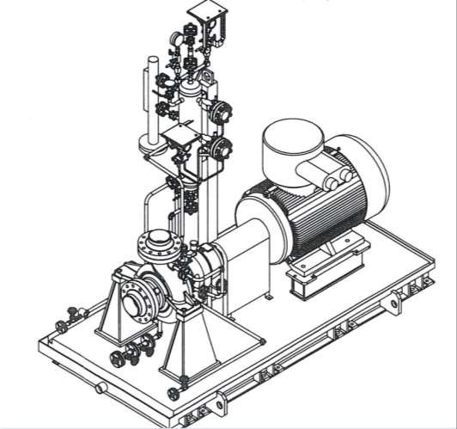
OH2型 OH2 type
OH-2型卧式悬臂泵为端进、顶出，单级径 向剖分，采用中心线支撑的流程泵，适合 输送清洁或稍有污染、化学中性或腐蚀性、 低温或高温的介质。
OH-2 type horizontal cantilever pump is end-suction, top-discharge, single-stage radial split, and uses a centerline-supported design. Suitable for transporting clean or slightly contaminated, chemically neutral or corrosive, low-temperature or high-temperature media.

Slide 14
OH2型泵主要结构 OH2 type pump main structure
一、主要结构 Main Structure
泵体: 泵壳、泵盖和密封压盖组成， 承受全部压力和介质温度产生的热负荷。
Pump casing: The pump casing, pump cover, and sealing gland form the pump body, which withstands the entire pressure and the thermal load generated by the temperature of the conveyed medium.
转子部件: 轴、叶轮、轴套等组成。
Rotor components: Composed of the shaft, impeller, shaft sleeve, and others.
轴承部件: 安装在轴承座内，对转子起支撑作用， 并承受轴向力和径向力。
Bearing components: Installed within the bearing housing, they support the rotor and withstand both axial and radial forces.
注: 耐磨离心泵: 增加耐磨衬板。
Note: Abrasive-resistant centrifugal pump: Equipped with wear-resistant liners.

Slide 15
OH2型泵主要结构 OH2 type pump main structure
二、结构特点 Structural Features:
1、壳体近中心线支承， 径向剖分，单级单吸， 重载设计，应用于高温、高压场合。
The casing is supported near the centerline, with a radial split, single-stage single-suction design, and heavy-duty construction, suitable for high-temperature and high-pressure applications.
2、完全符合API610 、API682 规范。
Fully complies with API 610 and API 682 standards.

Slide 16
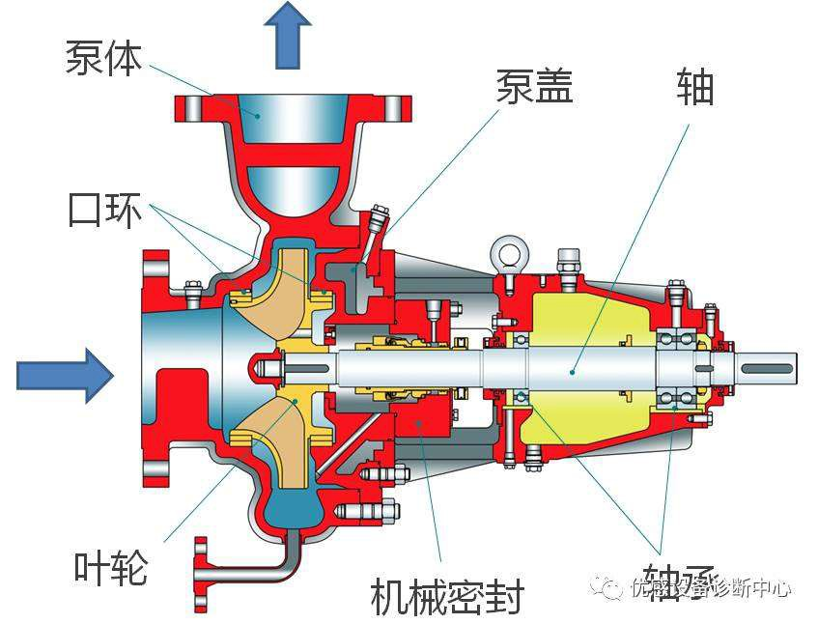
OH2
Pump body
Pump cover
Shaft
Wear ring
Impeller
Bearing
Mechanical Seal

Slide 17
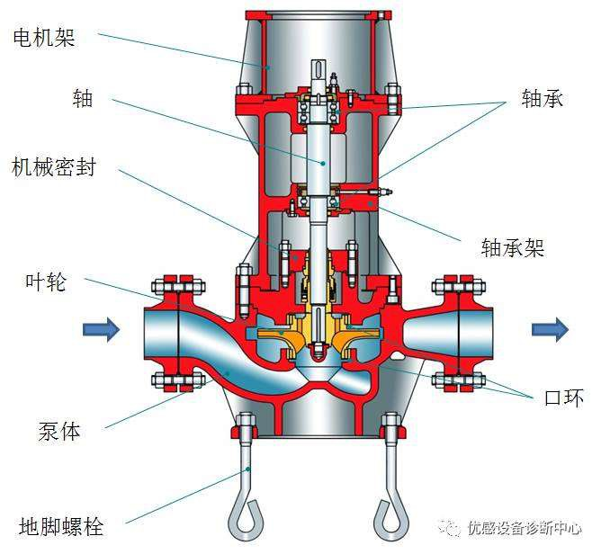
OH3型 OH3 type
OH-3型带有独立轴承架的立式管道泵，该 泵输送各种清洁的、或含有微量颗粒的介 质，也可输送易燃易爆、有毒的各种介质。 与同性能的卧式泵比较，此类型泵具有较 小的占地面积，节约基础投资成本。
应用范围： 主要用于石化、烃加工、炼油 厂、管线加压、供水及水处理等。
OH-3 type vertical pipeline pump with an independent bearing frame is designed to transport various clean or slightly particle-laden media, as well as flammable, explosive, or toxic substances. Compared to a horizontal pump with similar performance, this type of pump has a smaller footprint, saving on foundation investment costs.
Application range: Primarily used in petrochemical, hydrocarbon processing, refineries, pipeline pressurization, water supply, and water treatment industries.
Motor frame
Bearing
Shaft
Mechanical seal
Bearing frame
Impeller
Pump body
Wear ring
Foundation Bolt

Slide 18
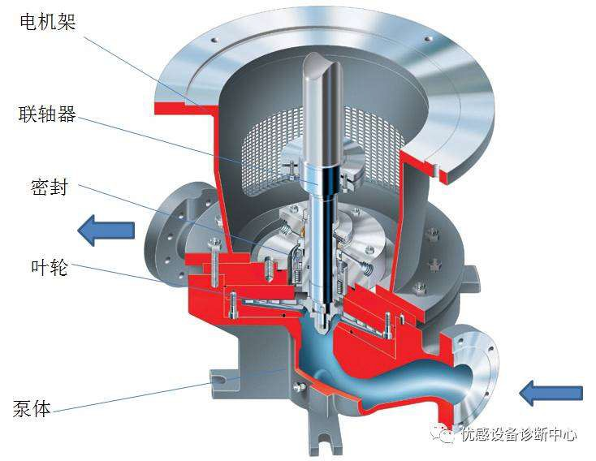
OH4型 OH4 type
OH-4型为刚性联轴器传动的立式管道单 级悬臂式泵，该泵输送各种清洁的、或 含有微量颗粒的介质。与同性能的卧式 泵比较，此类型泵具有较小的占地面积， 节约基础投资成本。此种型号的泵不满 足API610的所有要求。
应用范围：主要用于石化、烃加工、炼 油厂、管线加压、供水及水处理等。
OH-4 type is a vertical pipeline single-stage cantilever pump with a rigid coupling drive. This pump is designed to transport various clean or slightly particle-laden media. Compared to a horizontal pump with similar performance, this type of pump has smaller footprint, saving on foundation investment costs. This model does not meet all the requirements of API 610.
Application range: Primarily used in petrochemical, hydrocarbon processing, refineries, pipeline pressurization, water supply, and water treatment industries.
Motor frame
Coupling
Seal
Impeller
Pump body

Slide 19
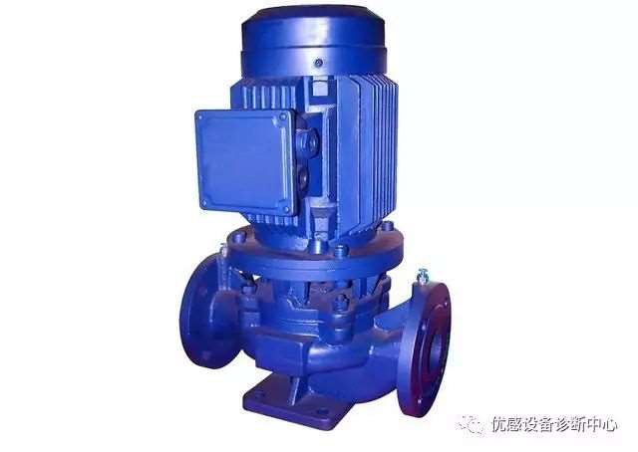
OH5型 OH5 type
OH-5型为共轴式立式管道单级悬臂式泵， 该泵输送各种清洁的、或含有微量颗粒的 介质，也可输送易燃易爆、有毒的各种介 质。与同性能的卧式泵比较，此类型泵具 有较小的占地面积，节约基础投资成本。 此种型号的泵不满足API610的所有要求。
应用范围：主要用于石化、烃加工、炼油 厂、管线加压、供水及水处理等。
OH-5 type is a coaxial vertical pipeline single-stage cantilever pump. This pump is designed to transport various clean or slightly particle-laden media, as well as flammable, explosive, or toxic substances. Compared to a horizontal pump with similar performance, this type of pump has a smaller footprint, saving on foundation investment costs. This model does not meet all the requirements of API 610.
Application range: Primarily used in petrochemical, hydrocarbon processing, refineries, pipeline pressurization, water supply, and water treatment industries.

Slide 20
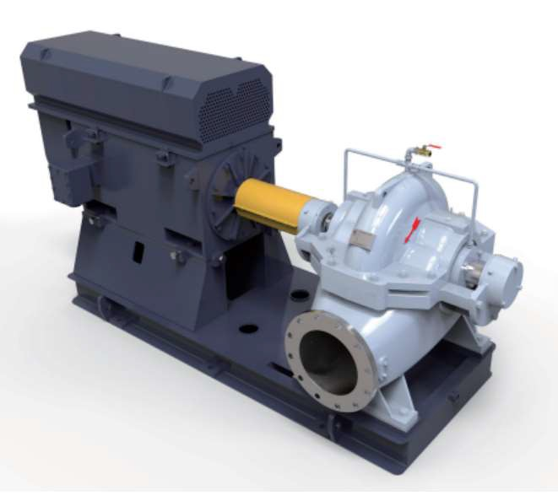
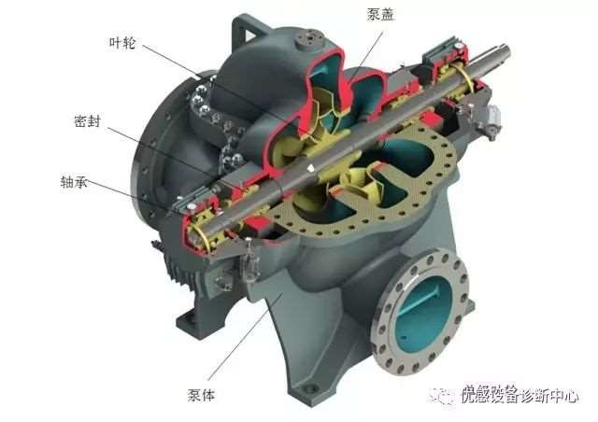
BB1型 BB1 type
Impeller
Pump cover
Seal
Bearing
Pump body

Slide 21
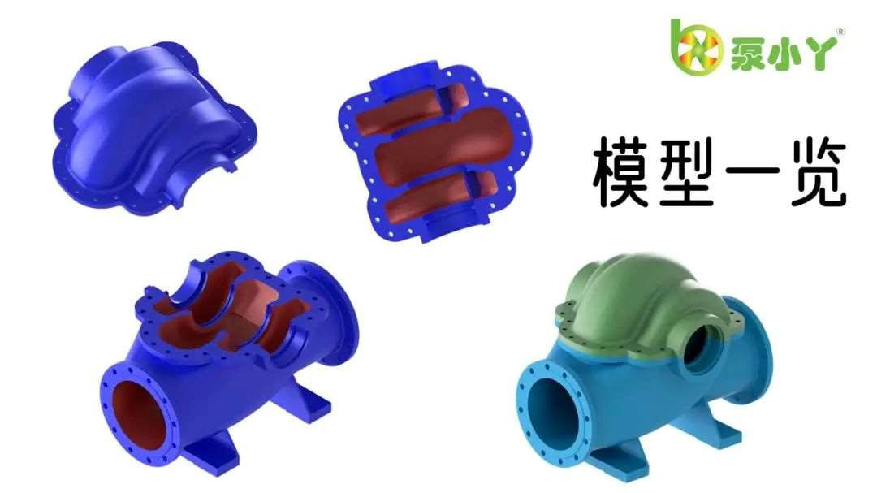
BB1型 BB1 type
BB1系列泵是轴向剖分、单级或两级、 蜗壳式、两端支承卧式离心泵，也可 设计为立式结构。适用于输送各种清 洁或含有微量颗粒的、中性或有腐蚀 性的介质。BB1系列泵符合美国石油 学会 API610 10th/API 610 11th设计 标准。
应用范围：广泛应用于各种工业流程、 污水处理、电站、热电厂、管网加压、 原油或成品油的输送、天然气的输送、 水力灌溉、供水与水处理、船用泵、 海水淡化等场合。
BB1 series pump is an axially split, single-stage or two-stage, volute-type, double-end supported horizontal centrifugal pump, which can also be designed in a vertical structure. Suitable for transporting various clean or slightly particle-laden, neutral or corrosive media. The BB1 series pump complies with the API 610 10th/API 610 11th design standards set by the American Petroleum Institute.
Application range: Widely used in various industrial processes, wastewater treatment, power plants, thermal power plants, pipeline pressurization, crude oil or refined oil transportation, natural gas transportation, hydraulic irrigation, water supply and treatment, marine pumps, seawater desalination, and other applications.

Slide 22
BB1型 BB1 type
轴向剖分双吸泵系卧式， 轴向剖分，单级两端支撑离心泵，泵体采用蜗壳式、底脚支撑结构。
The axially split double-suction pump is a horizontal, axially split, single-stage, double-end supported centrifugal pump, and adopts a volute-type, base-mounted structure.
该系列泵采用轴向剖分结构，结构紧凑，外形美观，稳定性好，便于安装， 维修方便快捷。
This series of pump adopts an axially split structure, which is compact, aesthetically pleasing, stable, and easy to install, and allows for convenient and quick maintenance.
叶轮采用双吸结构，具有流量、扬程范围广，效率高、汽蚀性能好的特点，是新一代的高效节能产品。
The impeller adopts a double-suction structure, offering a wide range of flow and head, high efficiency, and excellent cavitation performance. It is a new generation of efficient and energy-saving products.

Slide 23
BB1型 BB1 type
适合输送各种清洁或含有微量颗粒的、中性或有腐蚀性的介质。
Suitable for transporting various clean or slightly particle-laden, neutral or corrosive media.
广泛的应用在工业流程、水利灌溉、污水处理、供水与水处理、石油化工、电站、热电厂、管网加压、原油（成品油）输送等场合。我公司主要在循环水场、余热回收装置使用。
Widely used in industrial processes, hydraulic irrigation, wastewater treatment, water supply and treatment, petrochemical industries, power plants, thermal power plants, pipeline pressurization, crude oil (refined oil) transportation, and other applications. Our company mainly uses it in circulating water systems and waste heat recovery units.

Slide 24
BB1型优缺点 BB1 Pros & Cons
1、主要的优点 Main advantages
双吸叶轮，具有流量大、效率高等特点，流量和压力都平稳， 没有波动。
Double-suction impeller, featuring large flow rate and high efficiency. The flow and pressure remain stable without fluctuations.
中开泵可以与电机或汽轮机直接相连，传动机构简单紧凑。
The split-case pump can be directly connected to a motor or steam turbine, resulting in a simple and compact transmission mechanism.
该型泵吸入口和排出口均在泵轴心线下方，检修时，只要将泵盖揭开，即可将全部零件拆下进行 维修。
The suction and discharge ports of this type of pump are both located below the pump shaft centerline. During maintenance, simply removing the pump cover allows for the disassembly and repair of all components.

Slide 25
BB1型优缺点 BB1 Pros & Cons
2、主要缺点 Main disadvantages
一般情况下，启动前需先灌泵或用真空泵将泵内空气抽出。
Generally, before starting, the pump needs to be primed or the air inside must be removed using a vacuum pump.
液体黏度对泵的性能影响较大。当液体黏度增加时， 泵的流量、扬程、吸程和效率都会显著降低。
The viscosity of the liquid has a significant impact on the pump’s performance. As the liquid viscosity increases, the pump’s flow rate, head, suction capacity, and efficiency all decrease significantly.
中开泵在小流量、高扬程的情况下应用，受到一定的局限。
The split-case pump has certain limitations when applied in low-flow, high-head conditions.

Slide 26
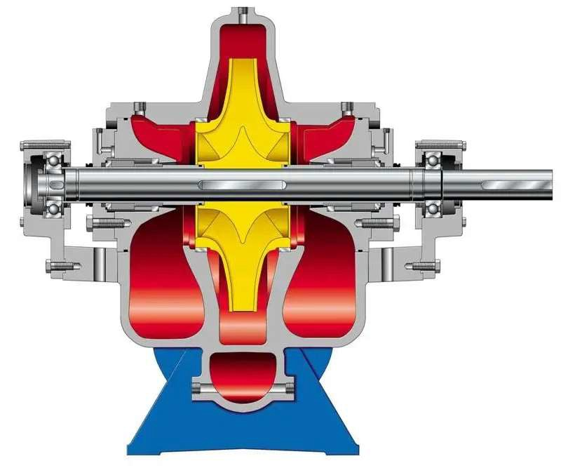
BB2型 BB2 type

Slide 27
BB2型结构特点 BB2 Structural Features
主要结构: 主要由泵体、泵盖、轴、叶轮、密封环、轴套、轴承部件等组成。
Main structure: Mainly consists of the pump body, pump cover, shaft, impeller, sealing ring, shaft sleeve, bearing components, and other parts.
结构特点 Structural features:
1 、中心线安装、两端支撑结构， 能够满足高温高压工况的要求;
The centerline installation and double-end support structure can meet the requirements of high temperature and high-pressure operating conditions.
2 、径向剖分结构， 泵体与泵盖之间采用金属缠绕垫， 可保证高温高压下的密封效果， 不会泄漏;
Radial split structure, with a metal spiral wound gasket between the pump body and pump cover, ensuring a reliable seal under high temperature and high-pressure conditions, preventing leakage.
3 、双蜗壳结构， 减少径向力， 降低转子的挠度， 提高轴的强度;
Double volute structure, which reduces radial forces, minimizes rotor deflection, and enhances the strength of the shaft.

Slide 28
BB2型结构特点 BB2 Structural Features
4 、法兰方向: 进、出口法兰在泵顶部或者采用侧进上出结构， 维修时不必拆卸管路， 简单易行。
Flange orientation: The inlet and outlet flanges are located at the top of the pump or use a side inlet and top outlet structure. During maintenance, the pipeline does not need to be disassembled, making the process simple and convenient.
5 、采用双吸叶轮， 降低了泵的汽蚀余量， 减少装置的安装造价; 同时双吸叶轮能够平衡自身产生的轴向力;
The use of a double-suction impeller reduces the pump’s NPSH (Net Positive Suction Head), lowering the installation cost of the system. At the same time, the double-suction impeller balances the axial forces it generates.
6 、首级双吸+次级单吸结构: 首级双吸提高泵的吸入性能， 次级叶轮平衡孔平衡两侧压力， 通过平衡管路使 两侧密封腔压力几乎相同。残余微量轴向力由轴承承受， 减少轴承负荷。对汽蚀性能要求较高的工况应采用 此种结构。
First-stage double-suction + second-stage single-suction structure: The first-stage double-structure enhances the pump’s suction performance, while the balance holes in the second-stage impeller balance the pressure on both sides. The balance pipeline ensures that the pressures of the sealing chambers on both sides are nearly identical. The residual micro-axial force is absorbed by the bearings, reducing bearing load. This structure should be used in conditions where cavitation performance is a critical requirement.
7 、两级单吸背对背或面对面结构: 叶轮自身的平衡孔平衡轴向力， 通过平衡管路使两侧密封腔压力几乎相同。 残余微量轴向力由轴承承受， 减少轴承负荷。对汽蚀性能要求不高的工况， 为了提高效率可以使用此种结构。
Two-stage single-suction back-to-back or face-to-face structure: The balance holes in the impellers themselves balance the axial force, and the balance pipeline ensures that the pressures of the sealing chambers on both side are nearly identical. The residual micro-axial force is absorbed by the bearings, reducing bearing load. This structure can be used in conditions where cavitation performance is not critical, as it helps improve efficiency.

Slide 29
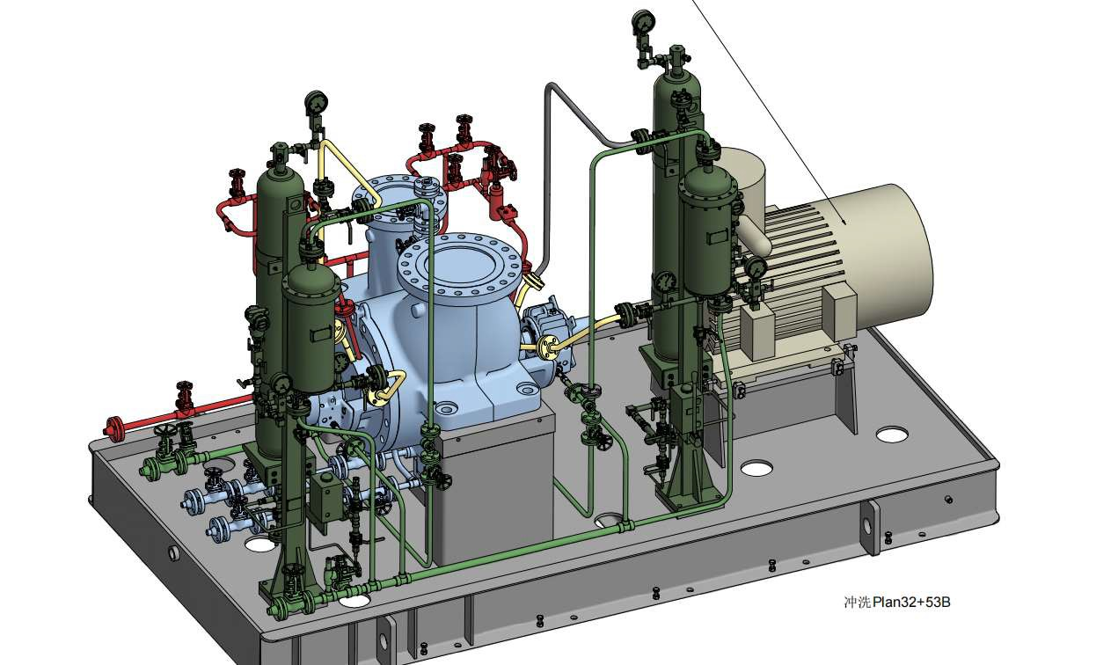
BB2型 BB2 type

Slide 30
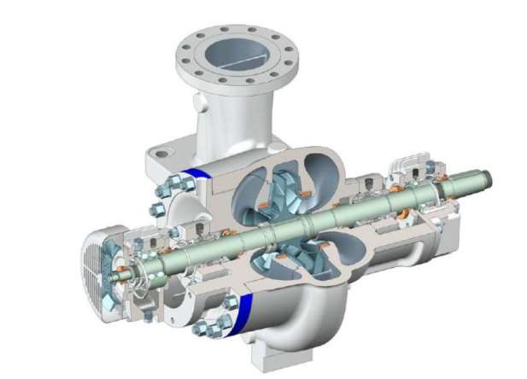
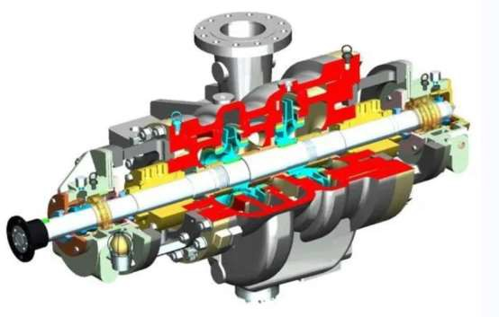
BB2型结构图 BB2 Structural diagram
BB2 型单级双吸
BB2 type single-stage double-suction
BB2 型两级，首级双吸
BB2 type two-stage, first-stage double-suction

Slide 31
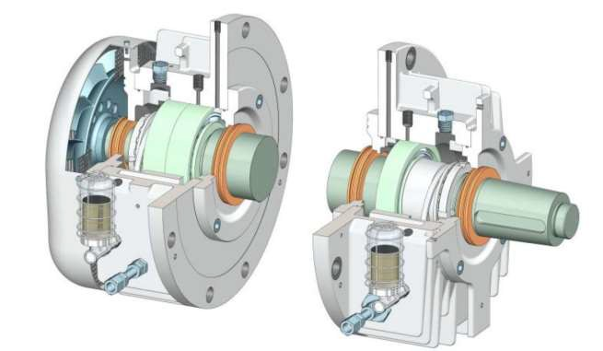
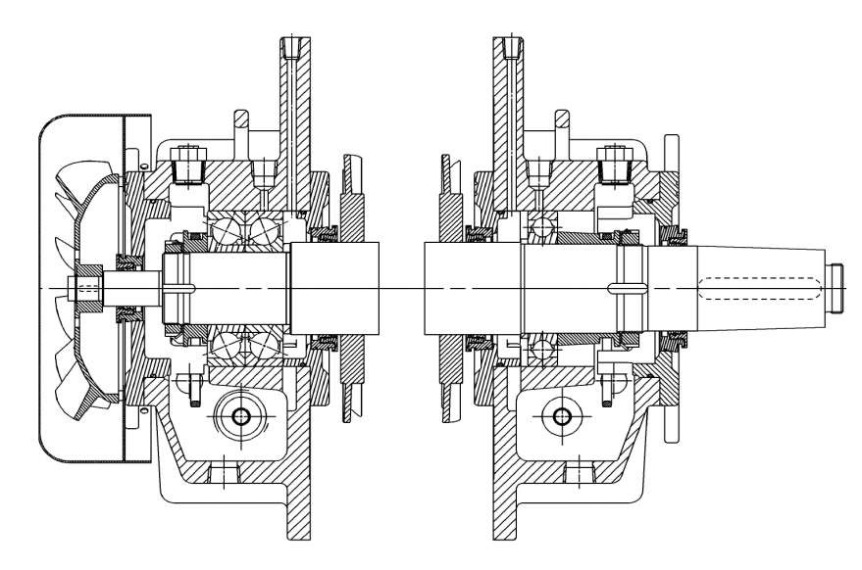
轴承箱结构 Bearing structure

Slide 32
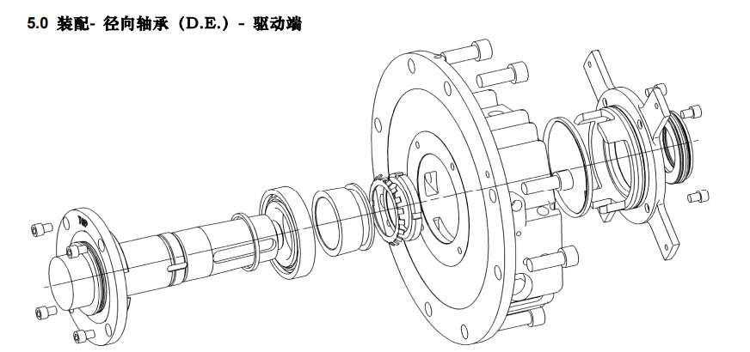
驱动端轴承装配图 DE bearing assembly diagram

Slide 33
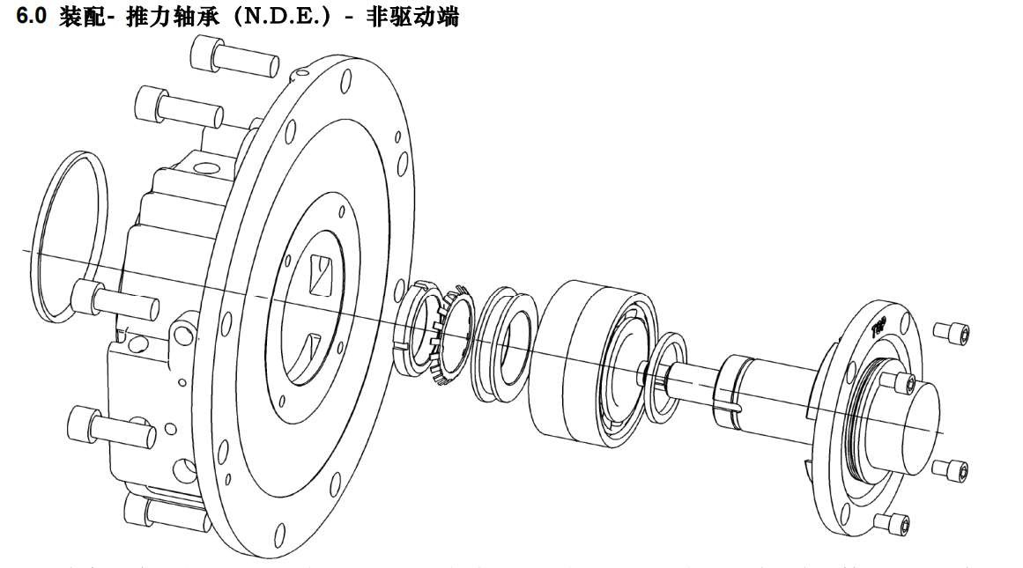
非驱动端轴承装配图 NDE bearing assembly diagram

Slide 34
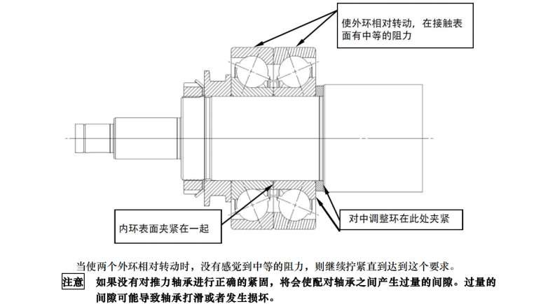
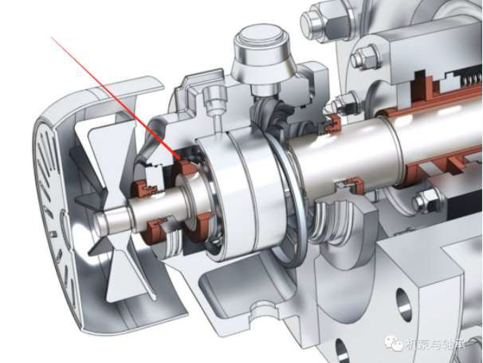
背靠背角接触球轴承的安装 Installation of back-to-back angular contact ball bearings
Rotate outer ring relative to each other, there is moderate resistance on the surface
The centered adjustment ring is clamped here
The inner ring surface is clamped together
When two outer rings are rotated relative to each other, and no moderate resistance is felt, continue to tighten until this requirement is reached.
Note: If the thrust bearing is not tightened correctly, it will cause excessive clearance between the paired bearings. Excessive gap may cause the bearing to slip or be damaged.

Slide 35
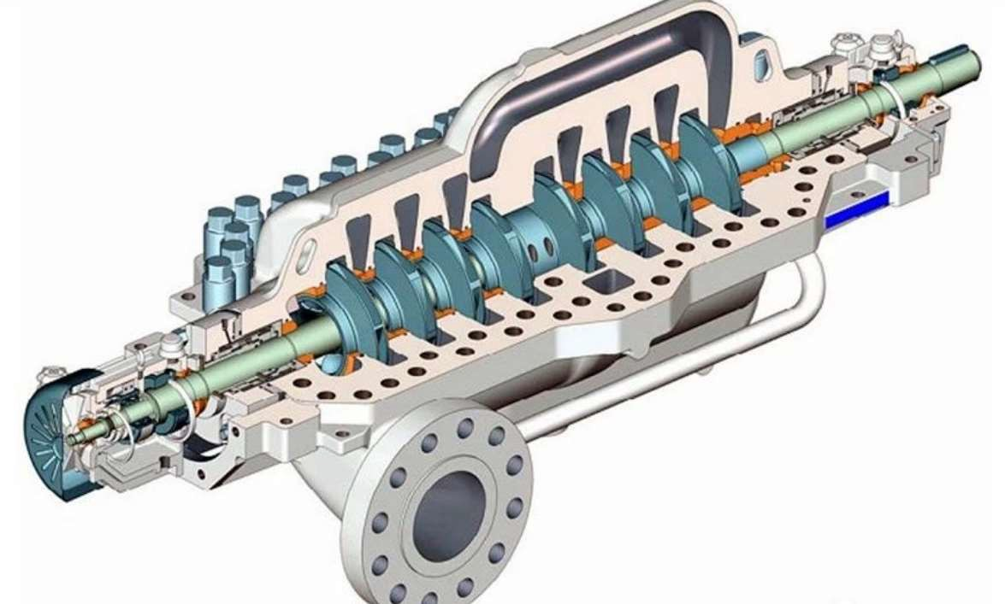
BB3型 BB3 type

Slide 36
BB3型结构特点 BB3 Structural Features
1 、泵壳为蜗壳式水平中开结构， 中心线支承， 叶轮采用对称布置， 轴向力自动平衡， 没有复杂的平衡盘、 平衡鼓等平衡机构。
The pump casing is of a volute-type horizontal split structure, with centerline support. The impeller is symmetrically arranged, and the axial force is automatically balanced without the need for complex balancing devices such as balance discs or balance drums.
2 、有利于叶轮对称布置， 减少作用在转子上的轴向力。
It is beneficial for the symmetrical arrangement of the impeller, reducing axial force acting on the rotor.
3 、级数越多， 泵体和泵盖的形状越复， 泵的外形尺寸越大， 特别是级与级之间需要配置一些级间流道， 使 泵的外形比较复杂。
The more stages there are, the more complex the shape of the pump body and pump cover becomes, and the larger the overall dimensions of the pump. In particular, inter-stage flow passages need to be configured between stages, making the pump’s overall shape relatively complex.
4 、当级数较多、扬程较高时， 中分面的密封难度较大。
When there are many stages and the pump head is high, sealing the mid-plane becomes more difficult.

Slide 37
BB3型结构特点 BB3 Structural Features
5 、首级叶轮易于采用双吸结构， 抗汽蚀性能好。可用于装置汽蚀余量要求较高的工况。减小装置汽蚀余量， 能够降低建设成本。
The first-stage impeller is easy to adopt a double-suction structure, providing good cavitation resistance. It can be used in conditions where the cavitation margin requirement is high. Reducing the cavitation margin of the system helps lower construction costs.
6 、泵壳体刚性好， 运行稳定性好， 振动小。
The pump casing has good rigidity, ensuring stable operation with minimal vibration.
7 、在输送含有固体颗粒的介质时， 所有摩擦副选用较高硬度的耐磨材料。
When transporting media containing solid particles, all friction pairs are made of high-hardness, wear-resistant materials.

Slide 38
BB3型结构特点 BB3 Structural Features
8 、采用中开式结构便于检修，进出口在泵体上侧进侧出，检修时无需拆卸进出口管道和移动泵体 ， 只要打开泵盖即可。
The split-case structure facilitates maintenance, with the inlet and outlet located on the upper side of the pump body (side inlet, side outlet). During maintenance, there is no need to disassemble the inlet and outlet pipelines or move the pump body; simply removing the pump cover is sufficient.
9 、在维修转子部件时， 只需把转子部件整体吊出， 把备用转子放入即可， 大大缩短了检修时间。
When servicing the rotor components, the entire rotor assembly can be lifted out and replaced with a spare rotor, significantly reducing maintenance time.

Slide 39
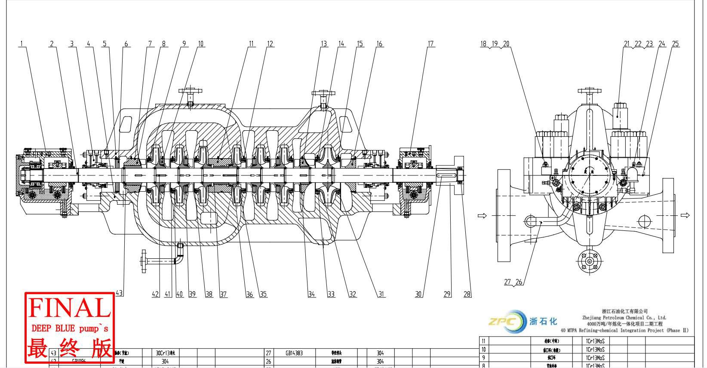
BB3型结构图 BB3 Structural diagram

Slide 40
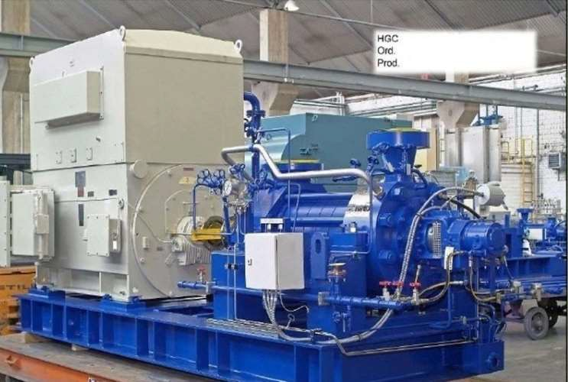
BB4型 BB4 type

Slide 41
BB4泵的结构特点 BB4 Pump structural features
这种泵所需的各叶轮、中段( 含导叶) 的两端装有吸入段和排出段， 然后把这些零部件用穿杠把紧， 泵的两端 装有轴承.
This type of pump requires that each impeller and middle section (including guide vanes) have an inlet and outlet section at both ends. These components are then tightened together using tie rods, with bearings installed at both ends of the pump.
BB4型多级离心泵泵体采用底脚支撑和中心支撑两种。
The BB4 type multistage centrifugal pump body uses two types of support: foot support and center support.
吸入口为单级或双吸径向剖分多级卧式节段式结构。
The suction inlet is designed with a single-stage or double-suction radial split multi-stage horizontal sectional structure.
通常出水口的方向是向上的， 进水管的方向是水平的或向上的。
Typically, the discharge outlet is oriented upward, while the inlet pipe direction is either horizontal or upward.

Slide 42
BB4泵的结构特点 BB4 Pump structural features
轴向力平衡 Axial force balance:
1)每一级叶轮产生的轴向力由所设置的平衡装置平衡， 剩余轴向力由推力轴承承担。
The axial force generated by each impeller in a stage is balanced by the provided balancing device, and the remaining axial force is borne by the thrust bearing.
2)靠叶轮背靠背布置， 平衡轴向力， 剩余轴向力由推力轴承承担。
The impellers are arranged back-to-back to balance the axial force, with the remaining axial force being borne by the thrust bearing.
两端轴承 Bearings at both ends:
1)如两端径向轴承采用滚动轴承， 利用向心推力球轴承平衡残余轴向力。
If rolling bearings are used for the radial bearings at both ends, a centrifugal thrust ball bearing is employed to balance the residual axial force.
2)如两端径向轴承采用滑动轴承， 利用向心推力球轴承或滑动推力轴承平衡残余轴向力。
If sliding bearings are used for the radial bearings at both ends, a centrifugal thrust ball bearing or sliding thrust bearing is employed to balance the residual axial force.

Slide 43
结构紧凑， 有利于提高标准化、通用化程度。由于这种结构的扬程取决于泵的级数， 所以这种多 级泵型号的扬程范围较宽.
The structure is compact, which helps improve the degree of standardization and versatility. Since the head of this structure depends on the number of stages, the head range of this type of multistage pump is relatively wide.
外部承压零件可采用铸造或锻造两种制作方法进行制造。
External pressure-bearing components can be manufactured using either casting or forging methods.
首级叶轮可设计成单吸或双吸两种结构，( 首级双吸应用于大规格，低汽蚀情况)。
The first-stage impeller can be designed in either single-suction or double-suction structures, with the first-stage double-suction being used for large sizes and low cavitation conditions.
当首级叶轮采用双吸结构时，几何尺寸大，结构复杂，在同样叶轮直径的情况下，轴跨度加长， 降低了转子刚性，降低了运行的稳定性。
When the first-stage impeller adopts a double-suction structure, the geometric dimensions are larger, and the structure is more complex. With the same impeller diameter, the shaft span is increased, which reduces the rotor rigidity and lowers the operational stability.
采用导叶结构， 流道过流面积小， 流速较快，冲刷磨蚀较快检修、拆卸难度大， 必须拆卸进出口 管道，移动泵体，依次拆卸泵的进出水段、中段、导叶、叶轮等主要零部件，维修周期较长。
The use of a guide vane structure results in a smaller flow passage cross-sectional area, higher flow velocity, and faster erosion and abrasion. Maintenance and disassembly are difficult; it is necessary to disassemble the inlet and outlet pipelines, move the pump body, and sequentially remove key components such as the inlet and outlet sections, middle section, guide vanes, and impellers. As a result, the maintenance cycle is longer.

Slide 44
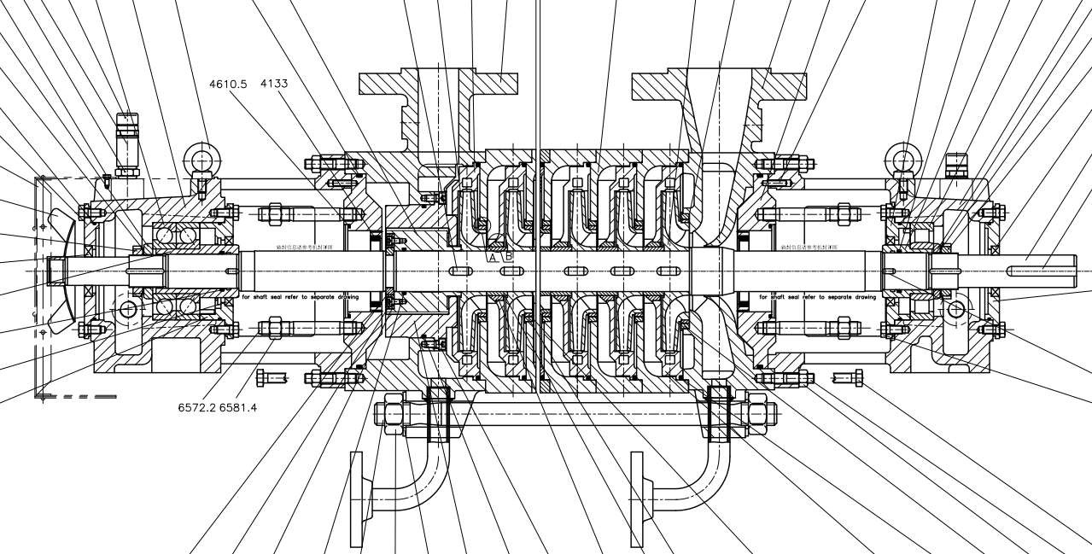
BB4型结构图 BB4 Structural Diagram

Slide 45
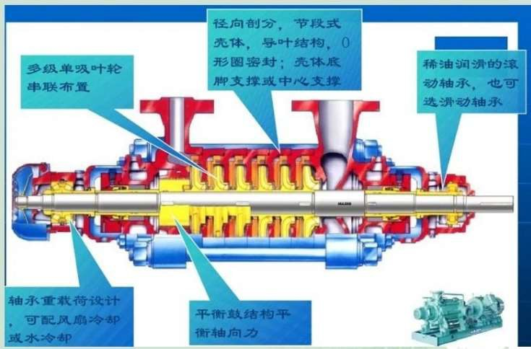
Radially split, segmented casing, guide vane structure, O-ring seal; shell bottom foot support or center support
Multistage single-suction impeller arranged in series
Oil-lubricated rolling bearings, or can choose sliding bearings
Bearing heavy load design, can be equipped with air cooling or water cooling
Balanced structure balances axial force

Slide 46
Sectional Multistage Pump
Middle
section
Guide
vane
Discharge
section
Additional
section
Bearing frame
Inlet section
Impeller
Bearing frame
Spacer sleeve
Packing shaft sleeve
Spacer ring
Throttle sleeve

Slide 47
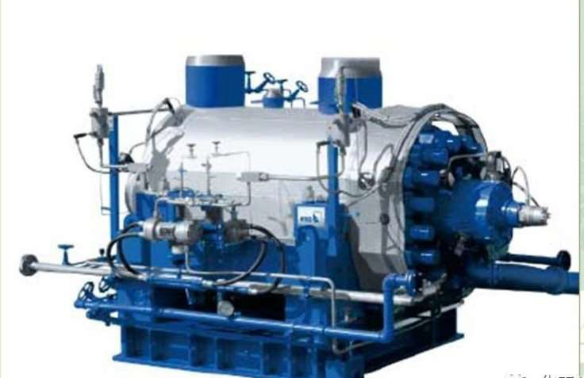
BB5型 BB5 type

Slide 48
结构特点 Structural Features
BB5泵为双壳、径向剖分、多级两端支承式泵。
BB5 pump is a double-casing, radial split, multistage, both-end supported pump.
泵体是双层结构，在内外壳体之间充满压出压力的高压水，内壳体只承受外压。
The pump body has a double-layer structure, with high-pressure water from the discharge pressure filling the space between the inner and outer casings. The inner casing only bears the external pressure.
外壳体因为只是一个圆筒，设计、制造、检修都很方便。
The outer casing is simply a cylinder, making it easy to design, manufacture, and maintain.
在圆筒形的外壳体内，装有带流道的内壳体，筒盖装在一侧，内壳体有水平中开式和分段式两种结构
Inside the cylindrical outer casing, there is an inner casing with flow passages, and a cylinder cover is mounted on one side. The inner casing can have either a horizontal split or sectional structure.

Slide 49
水平中开结构采用叶轮对称布置， 以平衡轴向力。分段式采用导叶结构，叶轮按同一方向布置， 采用平衡盘或平衡鼓平衡轴向力。
The horizontal split structure uses a symmetrical arrangement of impellers to balance the axial force. The sectional structure employs guide vanes, with impellers arranged in the same direction, and uses a balance disc or balance drum to balance the axial force.
内芯采用整体抽出式设计，在不移动进、出口管线的情况下能够实现泵的检测与维修。
The inner core adopts an integrated pull-out design, allowing the pump to be inspected and maintained without moving the inlet and outlet pipelines.

Slide 50
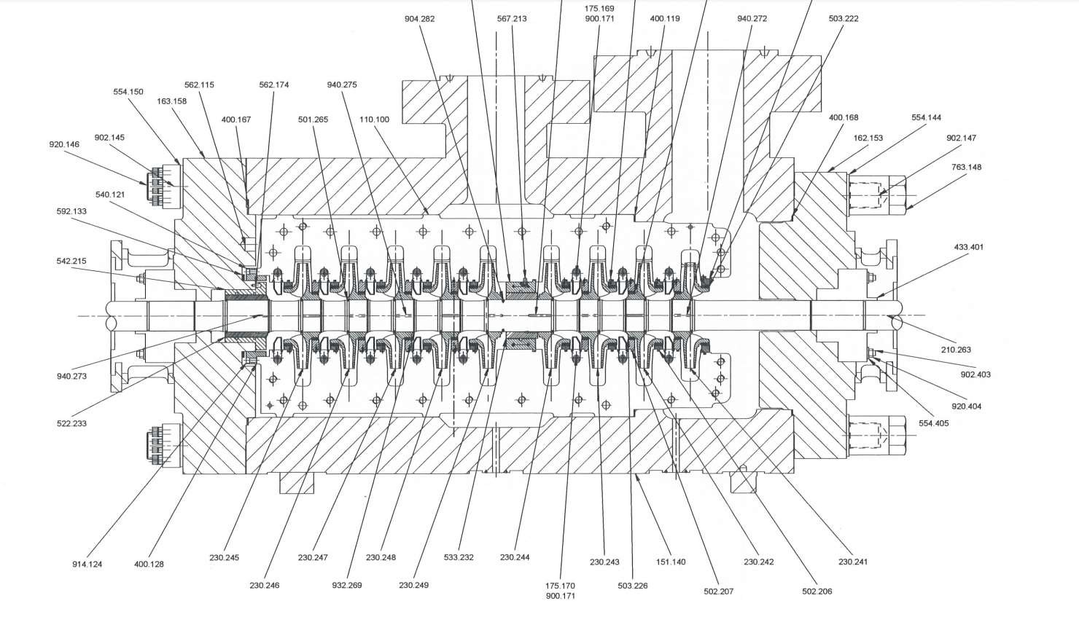
BB型结构图 BB Structural diagram

Slide 51
离心泵的定期检修维护 Centrifugal Pump Regular Maintenance and Inspection
每六个月应做以下检查工作:
The following checks should be performed on a centrifugal pump for every six months:
对干装配轴封填料的泵， 应该检查填料函压盖的自由位移量， 应清理和润滑压盖的螺栓， 并目应 该检查填料以确定是否需要更换。
For pumps with dry-packed shaft seals, the following should be checked, i.e. check the free displacement of the packing box pressure cover, clean and lubricate the pressure cover bolts, and visually inspect the packing to determine if it needs to be replaced.
- 如果需要， 应检查和校正泵和驱动机的对中性。
If necessary, check and correct the alignment between the pump and the drive end (DE)
- 油润滑轴承箱排干、冲洗并用新油重新充满。
Drain, flush the lubricating oil bearing box, and refill it with new oil.
- 应该检查润滑脂润滑的轴承，查看轴承是否含正确数量的润滑脂并且是否仍然具有合适的稠度。
The grease-lubricated bearings should be checked to ensure they contain the correct amount of grease and that the grease still has proper consistency.

Slide 52
离心泵的定期检修维护 Centrifugal Pump Regular Maintenance and Inspection
检查振动趋势。如果振动出现异常则需要
Check the vibration trend. If abnormal vibration is detected,
i、应拆开轴承箱， 清洗并检查轴承箱是否有伤痕和磨损， 以及轴承箱内是否由杂质。
The bearing box should be dismantled, cleaned, and inspected for any scratches, wear or the presence of impurities inside the bearing box.
ii、应仔细地清洗轴承箱。
The bearing box should be carefully cleaned.
iii、应检查滚动轴承是否有刮伤和磨损。
The rolling bearings should be inspected for scratches and wear.
iv、清洗后应立即用油或润滑脂涂敷可重新使用的滚动轴承。注意; 如果有任何损伤的迹象， 即轴承在拆除期间 受到损伤， 应该用新的。
After cleaning, reusable rolling bearings should be immediately coated with oil or grease. Note: If there are any signs of damage or if the bearing was damaged during removal, it should be replaced with a new one.
v、装配好的转子或主要转子部件， 在重新装配前， 应检查其动平衡。
The assembled rotor or main rotor components should be checked for dynamic balance before reassembly.

Slide 53
离心泵的定期检修维护 Centrifugal Pump Regular Maintenance and Inspection
- 对装有轴封填料的泵， 应拆除填料， 并应检查轴套或轴是否有磨损。
For pumps with shaft packing, the packing should be removed, and the shaft sleeve or shaft should be inspected for wear.
- 对装机械密封的泵， 如果机械密封出现泄漏， 则应更换并由密封厂家拆检查找原因。
For pumps with mechanical seals, if leaking occurs, the seal should be replaced and sent to the seal manufacturer for inspection to determine the cause.
-所有辅助管线， 如放水、密封水管线和冷却水管线及冷却器， 当需要时都应该被检查和冲洗。
All auxiliary pipelines, such as drainage, seal water pipelines, colling water pipelines, and coolers, should be inspected and flushed when necessary.
- 装配填料函的泵应换填料， 而且， 泵和驱动机应重新找正和重新连接。
Pumps with packed stuffing boxes should have the packing replaced. Additionally, the pump and drive end should be realigned and reconnected.
注意- 应重新校准所有的仪表和流量计。
Note: All instruments and flow meters should be recalibrated.
检修之后的机泵， 要进行试运行， 以确定是否完好备用。
After maintenance, the pump should undergo a test run to ensure it is in good working condition and ready for use.

Slide 54
启泵前的检查 Pre-inspection before startup pump
为保证泵的安全运行，在启动前，应对整个泵组做全面的检查，发现问题，及时处理。检查内容如下：
To ensure safe operation of the pump, a comprehensive inspection of the entire pump should be carried out before startup. Any issues found should be addressed promptly. The inspection are as follows:
1） 检查机泵周围有无杂物， 各部位螺栓无松动。
Check for any debris around the pump and ensure all bolts in various parts are not loose.
2）检查各种仪表齐全准确、灵活好用。
Check that all instruments are complete, accurate, flexible, and in good working condition.
3）检查填料、机封无明显泄漏。
Check that there is no leakage from the packing or mechanical seal.
4）检查机封辅助系统温度、压力、流量、液位正常。
Check that the temperature, pressure, flow, and liquid level of the mechanical seal auxiliary system are normal.
5）检查机泵伴热冷却循环系统流通良好。
Check that the pump heating and cooling circulation system is functioning properly.
6）检查联轴器螺栓紧固良好，护罩完好。
Check that the coupling bolts are securely fastened and that the protective cover is intact.
7）检查机泵润滑油油质合格，油位应在规定范围内。
Check that the pump lubrication oil meets quality standards and that the oil level is within the specific range.
8）检查电气设备和接地线完好。
Check that the electrical equipment and grounding wires are intact.

Slide 55
启泵前的准备 Preparation before Startup
经过全面检查，确认一切正常后，才可做启动的准备工作，主要有以下几项工作：
After a comprehensive inspection and confirmation that everything is normal, preparations for startup can proceed. The main tasks include the following:
1） 关闭排出管路上的阀门， 以便降低启动功率。
Close the discharge line valve to reduce the startup power.
2）打开泵入口阀门，向泵及过滤器内充满液体，同时放净过滤器及泵内气体，活动出口阀门。
Open the pump inlet valve to fill the pump and filter with media, and simultaneously remove any air from the filter and pump, ensuring the outlet valve is active.
3） 盘车灵活、不卡。
Ensure the pump shaft rotates smoothly.
4） 启泵前与有关岗位进行联系， 倒好相关流程。
Communicate with relevant positions before starting the pump and ensure the related processes are in order.

Slide 56
离心泵的启泵操作 Centrifugal Pump Startup
完成以上准备工作，即可启动泵，操作如下：
Once the preparation work is completed, the pump can be started, and the operation is as follows:
1） 按启动按钮，电流从最高值下降， 泵压上升稳定，缓慢打开泵的出口阀门， 根据生产需要，调节好泵压及流量。
Press ‘Start’button, observe the current decreasing from the maximum value as the pump pressure rises steadily. Slowly open pump outlet valve and adjust the pump pressure and flow rate according to production needs.
2）检查各种仪表指示是否正常，电动机的实际工作电流不允许超过额定电流。
Check that all instrument readings are normal, and ensure that the motor’s actual operating current does not exceed the rated current.
3）检查各静密封点不渗不漏。
Check that there is no leakage at any static sealing points.
4）检查动密封泄漏量是否超标。
Check if the dynamic seal leakage is within acceptable limits.

Slide 57
离心泵的启泵操作 Centrifugal Pump Startup
5）检查机泵无异常振动、噪音、气味。
Ensure that the pump does not have abnormal vibrations, noise, or odors.
6）检查机泵轴承不超温。
Check that the pump bearings are not overheating.
7）泵运行正常后，与相关岗位联系，随时注意罐液位变化，防止泵抽空、罐溢流。
Once the pump is running normally, communicate with relevant personnel and monitor the tank liquid level to prevent the pump from running dry or the tank from overflowing.
8） 记录相关生产数据，并做好全部记录。
Record the relevant production data and maintain all necessary records.

Slide 58
离心泵停泵操作 Centrifugal Pump Shutdown
1） 接到通知后做好停泵前的准备工作。
After receiving confirmation, prepare for the pump shutdown.
2） 关小泵出口阀门，当电流下降接近最低值时，按停止按钮，然后迅速关闭出口阀门。
Close the pump outlet valve, and when the current decreases to near the minimum value, press ‘Stop’ button, then quickly close the outlet valve.
3）泵停稳后盘车转动灵活，关闭进口阀门。
After the pump shutdown stabilizes, ensure the shaft rotates smoothly, and then close the inlet valve.
4） 做好停泵记录， 通知相关岗位。
Record the shutdown details and notify relevant personnel.

Slide 59
泵的启动（二）Pump startup (2)
1、确认吸入阀全开，排出阀关闭或微开； 有最小流量管路时，排出阀全关，全开最小流量阀。
Confirm that the suction valve is fully open, and the discharge valve is either closed or slightly open. If there is a minimum flow line, close the discharge valve fully and open the minimum flow valve fully.
2、关闭出口管路截止阀（必须保证最小流量）；
Close the discharge pipeline shut-off valve (ensure the minimum flow is maintained).
3、启动电机，使泵转子达到运转速度；
Start the motor to bring the pump rotor up to operating speed.
4、缓慢打开出口阀使泵的出口压力、流量达到规定数值。开出口阀同时应检查电机电流变化，避 免电机过载。在流量增加时，还应注意泵的密封有无异常泄漏、泵的振动情况是否正常、泵体和电机等有无异常声音、出口压力的变化等，如泵有异常的泄漏、异常的振动、异常的噪音或出口压力低于设计值，应查明原因并进行处理。
Slowly open the discharge valve to bring the pump's discharge pressure and flow rate to the specified values. While opening the discharge valve, monitor the motor current to avoid overload. As the flow rate increases, also check for abnormal seal leakage, pump vibrations, unusual sounds from the pump body and motor, and any changes in discharge pressure. If there are abnormal leaks, vibrations, noises, or if the discharge pressure is lower than the design value, investigate and address the issue.
5、当泵正常运转后，检查泵的出口压力、出口流量、电机电流、轴承和密封处的温度、润滑油的 油位、泵的振动、噪音以及密封处泄漏情况；（根据工艺需要）关闭最小流量旁路的阀门。做好相关设备运行记录。
After the pump is running normally, check the discharge pressure, flow rate, motor current, temperature of bearings and seals, oil level of lubrication, pump vibrations, noise, and any leakage at the sealing points. (As per process requirements) close the bypass valve for minimum flow. Record relevant equipment operational data.

Slide 60
停泵（二）Shutdown Pump (2)
1 、慢慢关小排出阀， 直到流量达到最小流量为止。
Slowly close the discharge valve until the flow rate reaches the minimum flow rate.
2、切断电源， 停泵， 关闭出口阀。
Cut off the power, stop the pump, and close the discharge valve.
3 、设有最小流量旁通管路时， 在旁通阀全开的情况下关闭排出阀， 然后切断电源停泵。高温泵要在降温到80℃以下时才可停止循环水； 密封系统（ 冲洗液、密封气） 要在停泵20 分钟以后视情况停止。
If a minimum flow bypass line is present, first open the bypass valve fully, then close the discharge valve, and finally cut off the power to stop the pump. For high-temperature pumps, the circulating water must be stopped only after the temperature drops to below 80°C. The sealing system (such as flushing liquid or sealing gas) should be stopped 20 minutes after the pump is stopped, depending on the situation.
4 、备用泵： 吸入阀全开， 排出阀全关（ 设有最小流量旁通管路时， 旁通阀全开， 排出阀全闭）， 从而使泵 内处于满液的吸入压力状态。备用泵的冷却水要继续投用， 保持润滑油液位不低于规定油位。冬季要特别注 意检查， 保持伴热线、冷却水畅通， 避免冻凝。
Standby pump: Keep the suction valve fully open and the discharge valve fully closed (if a minimum flow bypass line is present, open the bypass valve fully and keep the discharge valve closed), ensuring that the pump is in a fully flooded suction pressure state. The cooling water for the standby pump should continue to run, and the oil level should be maintained above the specified level. In winter, special attention should be given to checking the heat tracing and ensuring that the cooling water lines remain clear to avoid freezing.

Slide 61
停泵（二）Shutdown Pump (2)
5 、备用泵要按规定盘车。
The standby pump should be rotated periodically as required.
6 、 ( 停车后) 需要检修的泵， 停泵（ 降温） 后先关闭干气密封系统氮气入口阀， 将密封腔泄压， 再完全排出
泵内液体和冷却系统中的冷却水， 使泵体内的压力下降为零， 泵内残存的物料吹扫干净， 所有阀门全部关闭，
并且与变电所联系断电。现场处理要满足HSE要求。
(For pumps needing maintenance after shutdown) After stopping the pump (cooling down), first close the nitrogen inlet valve of the dry gas seal system, depressurize the seal chamber, then completely drain the liquid inside the pump and the cooling water from the cooling system. This will reduce the pressure inside the pump to zero and clear any residual materials. All valves should be closed, and the power should be cut off by contacting the substation. On-site handling must meet HSE requirements.

Slide 62
泵的切换 Pump switching
切换泵时应严格保证系统流量、压力不变原则， 严禁抽空、抢量等情况发生。
When switching pumps, the system flow and pressure must be strictly maintained, and situations such as cavitation or overloading must be avoided.
正常情况下的切换 Normal switching：
1 、备用泵应作好一切启动准备工作。
The standby pump should be fully prepared for startup.
2 、打开备用泵的吸入阀（ 灌泵充液、排气）， 按正常程序启动备用泵。
Open the suction valve of the standby pump (fill the pump with liquid and vent it), and start the standby pump following normal procedures.
3 、检查备用泵的出口压力、电流、振动、泄漏、温度等， 如都正常时， 可逐渐开大排出阀的开度， 同时逐 渐关小原运转泵的排出阀开度， 尽量保持系统流量， 压力不变。当备用泵出口压力和流量正常后， 关闭原运 转泵的排出阀并切断电源， 按停泵处理。
Check the outlet pressure, current, vibration, leakage, temperature, etc., of the standby pump. If everything is normal, gradually increase the opening of the discharge valve of the standby pump while gradually decreasing the opening of the discharge valve of the original running pump. Make every effort to keep the system flow and pressure stable. Once the standby pump's outlet pressure and flow are normal, close the discharge valve of the original running pump and cut off its power, treating it as a stopped pump.

Slide 63
泵的切换 Pump switching
紧急情况下的切换 Emergency switching：
离心泵紧急情况下的切换是指油喷出、电机起火、泵严重损坏等事故。
Emergency switching refers to situations such as oil spraying, motor fires, or severe pump damage.
1、备用泵应作好一切启动准备工作。
The standby pump should be fully prepared for startup.
2 、切断原运转泵的电源， 停泵， 启动备用泵。
Cut off the power to the original running pump and stop it, then start the standby pump.
3 、打开备用泵的排出阀， 使出口流量、压力达到规定值。
Open the discharge valve of the standby pump to bring the outlet flow and pressure to the required values.
4 、关闭原运转泵的排出阀和吸入阀， 对事故进行处理。
Close the suction and discharge valves of the original running pump and address the issue.

Slide 64
离心泵的日常巡检 Centrifugal Pump Daily Inspection
一、基本要求 Basic requirements
1 、巡检人员要求 Inspection personnel requirements：
巡检人员应具有安全作业上岗证。能正确使用测振仪、测温仪、测速仪等测量仪器， 以及听棒、常用工具。巡检人员具备一定的现场故障判断的实际经验和能力， 安全意识强， 有识险避险能力。
The inspection personnel should have a valid safety operation certificate. They must be able to correctly use instruments such as vibration meters, thermometers, tachometers, as well as stethoscopes and common tools. The inspection personnel should have practical experience and ability in diagnosing on-site faults, with strong safety awareness and the ability to identify and avoid risks.
2 、巡检线路频次要求 Inspection route requirements：
相应管理班组根据巡检区域划分按正常巡检次数、时间巡检， 要求确保无死角和设备漏检。按机泵状态监 测要求， 对设备监测， 记录要全面、完整。巡检问题要求及时、准确记录并汇总上报， 较紧急情况要求第一时 间通知相关生产单位进行确认和处理， 避免事态扩大。
The corresponding management team should conduct inspections according to the designated inspection areas, following the normal inspection frequency and times, ensuring that there are no blind spots and that no equipment is overlooked. According to the equipment monitoring requirements, the monitoring and recording of the pump's operational status should be comprehensive and complete. Any issues identified during the inspection should be promptly and accurately recorded and reported. In more urgent situations, the relevant production units must be notified immediately for confirmation and handling, to prevent the situation from worsening.

Slide 65
离心泵的日常巡检 Centrifugal Pump Daily Inspection
3 、巡检安全环保要求 Inspection Safety and Environmental Protection Requirements：
巡检人员应按照规定穿着合格的衣服、裤子和防护鞋， 正确佩戴安全帽、防护镜和耳塞等防护用品， 佩戴 硫化氢报警仪。随身携带合适的工具包， 记录本、巡检工具应能整齐存放， 无不规则外露， 工具包外部应无系 绳、毛边等可能与设备接触的不安全因素。随身携带合适尺寸的抹布， 对不易观察部位清洁使用， 使用后的抹 布要按照规定投入工业垃圾回收箱。尤其是女职工的长发不允许外露， 必须盘到安全帽内。
Inspection personnel should wear qualified clothing, pants, and protective shoes as per regulations, and correctly wear safety helmets, protective glasses, earplugs, and other protective equipment. They must carry a hydrogen sulfide alarm device. A suitable tool kit, notebook, and inspection tools should be carried and stored neatly, with no irregular exposure. The exterior of the tool kit should be free of unsafe factors like ropes or frayed edges that could come into contact with equipment. A suitable cloth should be carried to clean hard-to-reach areas. Used cloths must be disposed of in the industrial waste recycling bin according to regulations. In particular, female employees' long hair must not be exposed and must be tied up inside the safety helmet.
4 、巡检工具要求 Inspection Tool Requirements：
巡检人员携带配备工具： 活扳手、螺丝刀、手钳、听棒。携带配备测量仪器： 测振仪、测温仪。
Inspection personnel should carry the following tools: adjustable wrenches, screwdrivers, pliers, and listening sticks. They should also carry measuring instruments, such as a vibration meter and temperature meter.

Slide 66
离心泵的日常巡检 Centrifugal Pump Daily Inspection
二、检查内容与标准要求 Inspection Content and Standard Requirements
1、泄漏检查内容和标准 Leakage Inspection Content and Standards：
2、润滑检查内容和标准 Lubrication Inspection Content and Standard：
检查轴承箱轴承压盖轴封泄漏情况。轴封不允许有可见的泄漏， 挡油环不得松动。检查轴承箱润滑油检查： 润滑油油位为看窗高度的1/ 2— 2/3。润滑油应无乳化、变质、颜色变化（变黑） 等 情况。补油杯油位和补油情况。对于油雾润滑机泵，应检查供油雾总管、接油盒等储油油位，并 检查油雾供应情况。
Check the bearing box, bearing cap and shaft seal for leakage. The shaft seal should not have visible leakage, and the oil retaining ring must not be loose. Check the bearing box and check the lubricating oil: The lubricating oil level should be between 1/2-2/3 of the height of the sight glass. Lubricating oil should be free of emulsification, deterioration, color change (darkening), etc. Check the oil level and oil replenishment status of the oil replenishment cup. For oil mist lubrication pumps, check the oil mist supply line, oil collection box and oil storage levels, and verify the proper functioning of the oil mist supply.

Slide 67
离心泵的日常巡检 Centrifugal Pump Daily Inspection
3、机封冲洗、冷却系统检查内容要求：
Mechanical Seal Flushing and Cooling System Inspection Requirements:
检查机封冲洗管线、管件泄漏情况；
Check for any leakage in the mechanical seal flushing pipeline and fittings.
检查机封冲洗管线、法兰、接头完好情况；
Check the integrity of the mechanical seal flushing pipeline, flanges, and joints.
检查机封冲洗管线温度，是否畅通；
Check the temperature of the mechanical seal flushing pipeline to ensure it is unobstructed.
检查机封冷却水进、回水温度，是否畅通。
Check the temperature of the cooling water in and out of the mechanical seal to ensure proper flow.

Slide 68
离心泵的日常巡检 Centrifugal Pump Daily Inspection
4、外观检查内容和标准 Appearance Inspection Content and Standards：
检查泵出入口法兰、附属管线螺栓是否松动、缺失、泄漏情况。观察轴承箱的油封、机封的水封环松动情况。
Check if the pump inlet and outlet flanges, and associated pipeline bolts are loose, missing, or leaking. Observe the oil seals of the bearing housing and the water seals of the mechanical seals for any looseness.
检查联轴器护罩、地脚螺栓是否完好； 与联轴器是否摩擦，是否存在摆动情况。
Check if the coupling guard and anchor bolts are intact; check if there is any friction with the coupling, and if there is any oscillation.
泵体、电机的地脚螺栓、连接螺栓是否存在松动。观察泵出入口压力表是否存在较大波动。压力是否在现场表的正常范围内。观察泵轴是否存在窜轴现象。
Check if the anchor bolts and connection bolts of the pump body and motor are loose. Observe if there are significant fluctuations in the pump inlet and outlet pressure gauges. Ensure the pressure is within the normal range indicated on the field gauges. Check if there is any shaft movement (axial play) in the pump shaft.

Slide 69
离心泵的日常巡检 Centrifugal Pump Daily Inspection
5、声音检查内容和标准 Sound Inspection Content and Standards：
轴承箱内是否有杂音， 并用听棒初步判断杂音部位，用测振仪测量轴承运行情况， 如果是润滑 脂润滑在出现杂音时应首先添加润滑脂。观察泵体内是否有杂音，并判断杂音的来源，如气蚀、抽空、摩擦等。观察联轴器部位是否有杂音，地面上是否有联轴器传动零件散落，必要时使用频 闪仪观察联轴器螺栓是否松动，膜片、弹性胶圈是否损坏。
Check if there is any unusual noise in the bearing box, and use a listening stick to preliminarily determine the noise location. Use a vibration meter to measure the bearing's operating condition. If the pump is lubricated with grease, and unusual noise occurs, the first step is to add more grease. Observe if there is any noise in the pump body and identify the source of the noise, such as cavitation, dry running, or friction. Check if there is any noise in the coupling area and if any coupling parts have fallen on the ground. If necessary, use a strobe light to check if the coupling bolts are loose, or if the diaphragm and elastic rubber rings are damaged.

Slide 70
离心泵的日常巡检 Centrifugal Pump Daily Inspection
6、温度检查内容与标准 Temperature Inspection Content and Standards：
用测温仪检查轴承温度。★测量轴承箱温度时轴承温度：滑动轴承不大于65℃，滚动轴承不大于70℃。★对于强制润滑系统，轴承油的温升不应超过28℃， 轴承金属的温度应小于93℃，对于油环润滑或飞溅润滑系统，油池的温升不应超过39℃，油池温度应低于82℃。
When measuring the bearing box temperature, ★For sliding bearings, the temperature should not exceed 65°C; For rolling bearings, the temperature should not exceed 70°C. ★ For forced lubrication systems, the temperature rise of the bearing oil should not exceed 28°C, and the bearing metal temperature should be less than 93°C. For oil ring lubrication or splash lubrication systems, the temperature rise of the oil pool should not exceed 39°C, and the oil pool temperature should be below 82°C.
7、振动检查内容与标准 Vibration Inspection Content and Standards：
振动速度值不大于2.8mm/s，大泵应不大于4.5mm/s。
The vibration speed value should not exceed 2.8 mm/s for normal pumps. For large pumps, the vibration speed value should not exceed 4.5 mm/s.

Slide 71
高温泵巡检内容 High-Temperature Pump Inspection Content
1 ） 密封系统检查 Sealing System Inspection
①检查机封本体及机封辅助系统是否存在泄漏。
Check if there is any leakage from the mechanical seal body and its auxiliary systems.
②检查机封封油压力、温度、液位、颜色是否正常；
Check if the seal oil pressure, temperature, liquid level, and color are normal.
③检查机封隔离液油冷却水系统工作是否正常， 冷却水上水压力、回水温度是否超标， 机械密封背冷要采用 除盐水或压力不大于0 . 3 MPa的蒸汽， 严禁使用循环水或新鲜水对机械密封进行冷却。
Check if the mechanical seal isolation liquid cooling water system is working properly. Ensure the cooling water inlet pressure and return water temperature are within the required range. Mechanical seal back cooling should use demineralized water or steam with a pressure not exceeding 0.3 MPa. It is strictly prohibited to use circulating water or fresh water for cooling the mechanical seal.
④检查机封隔离液进 出温差是否正常， 确认隔离液循环正常。
Check if the temperature difference between the isolation liquid inlet and outlet is normal, and confirm that the isolation liquid circulation is functioning properly.

Slide 72
高温泵巡检内容 High-Temperature Pump Inspection Content
2 ） 轴承检查 Bearing Inspection
①测量轴承振动、温度数值， 是否超标或存在突变的情况；
Measure the bearing vibration and temperature values to check if they exceed the standard or show any sudden changes.
②高温泵转动部位声音有无异常；
Check if there are any abnormal sounds from the rotating parts of the high-temperature pump.
③检查轴承油封有无泄漏情况；
Check if there is any leakage from the bearing oil seals.
④检查轴承箱或润滑油冷却系统工作是否正常；
Check if the bearing housing or lubricating oil cooling system is functioning properly.
⑤检查轴承箱油位及润滑油颜色质量是否符合要求；
Check if the bearing housing oil level and the color and quality of the lubricating oil meet the requirements.
⑥采取强制润滑的机泵， 需检查润滑油泵工作是否正常。
For pumps with forced lubrication, check if the lubricating oil pump is working properly.

Slide 73
高温泵巡检内容 High-Temperature Pump Inspection Content
3 ） 附属管道检查 Auxiliary Piping Inspection
①检查与机泵相连接的各处管道法兰、阀门静密封是否存在泄漏；
Check if there are any leaks in the flanges and valve seals of the pipelines connected to the pump.
②检查机泵出口压力是否正常；
Check if the pump outlet pressure is normal.
③检查与机泵相连的各管道振动是否正常。
Check if the vibration of the pipelines connected to the pump is normal.

Slide 74
离心泵故障
序 号 | 故障现象 | 原因 | 处理方法
1 | 轴承发热 | (1)润滑油过多 (2)润滑油过少 (3)润滑油变质 (4)机组不同心 (5)振动 | 减油 加油 排去并清洗油池再加新油 检查并调整泵和原动机的对中 检查转子的平衡度或在较小流量处运转
2 | 泵输不出液体 | (1)吸入管路或泵内留有空气 (2)进口或出口侧管道阀门关闭 (3)使用扬程高于泵的最大扬程 (4)泵吸入管漏气 (5)错误的叶轮旋转方向 (6)吸上高度太高 吸入管路过小或杂物堵塞 转速不符 | 注满液体、排除空气 开启阀门 更换扬程高的泵 (4)杜绝进口侧的泄漏 (5)纠正电机转向 (6)降低泵安装高度，增加进口处压力 (7)加大吸入管径，消除堵塞物 (8)使电机转速符合要求
3 | 流量扬程不足 | 叶轮损坏 密封环磨损过多 转数不足 进口或出口阀未充分打开 (5)在吸入管路中漏入空气 (6)管道中有堵塞 (7)介质密度与泵要求不符 (8)装置扬程与泵扬程不符 | 更换新叶轮 更换密封件 按要求增加速 (4)充分开启 (5)把泄漏处封死 (6)消除堵物 (7)重新核算或更换合适功率的电动机 (8)设法降低泵的安装高度

Slide 75
离心泵故障
序 号 | 故障现象 | 原因 | 处理方法
4 | 密封泄漏严重 | (1)密封元件材料选用不当 (2)摩擦副严重磨损 动静环吻合不匀 摩擦副偏斜，静环破裂 (5)O型圈损坏 | (1)向供泵单位说明介质情况，配以适当的密封件 (2)更换磨损部件，并调整弹簧压力 重新调整密封组合件 整泵拆卸换静环，使之与轴垂直度误差小于0.10，按要求装密封 组合件 更换O型圈
5 | 泵发生振动及 杂音 | (1)泵轴和电机轴的中心线不对中 (2)轴弯曲 (3)轴承磨损 (4)泵产生汽蚀 转动部分与固定部分有磨损 转动部分失去平衡 管路或泵内有杂物堵塞 (8)关小了进口阀 | (1)校正对中 (2)更换新轴 (3)更换轴承 (4)向厂方咨询 (5)检修泵或改善使用情况 (6)检查原因，设法消除 (7)检查排污 (8)打开进口阀，调节出口阀
6 | 电机过载 | (1)泵和原动机不对中 (2)介质相对密度变大 (3)转动部分发生摩擦 (4)装置阻力变低，使运行点偏向大流量 处 | 调整泵和原动机的对中性 改变操作工艺 (3)修复摩擦部位 (4)检查吸入和排出管路压力与原来的变化情况，并予调整

Slide 76
Centrifugal Pump Failure
No. | Failure Symptoms | Reasons | Troubleshooting Methods
1 | Bearing overheat | Excessive lubricating oil Insufficient lubricating oil Oil degradation Misalignment of unit Vibration | Reduce oil Add oil Drain and clean the oil sump, then add new oil Check and adjust alignment of pump and DE Check balance of rotor or operate at lower flow rate
2 | Pump fails to deliver media | Air in suction line or inner pump Inlet or outlet valve on pipeline closed Using a head higher than pump’s maximum head Air leak in suction pipe Incorrect impeller rotation direction Suction height too high Suction pipe too small or blocked by debris Incorrect speed | Fill pump with media and remove air Open valve Replace with a pump of higher head Eliminate leaks on inlet side Correct motor rotation direction Reduce pump installation height and increase inlet pressure Increase inlet pipe diameter and remove blockages Ensure motor speed meets requirements
3 | Insufficient flow | Damaged impeller Excessive wear of seal ring Insufficient speed Inlet or outlet valve not fully open Air leaked into suction line Blockage in pipeline Medium density not match with pump’s requirements Unit head does not match the pump head | Replace the impeller Replace the seals Increase speed as required Fully open the valve Seal the leakage point Remove the obstruction Recalculate or replace with a suitable motor power Try to lower the pump installation height

Slide 77
Centrifugal Pump Failure
No. | Failure Symptoms | Reasons | Troubleshooting Methods
4 | Severe leaking leakage | Improper selection of sealing element material Severe wear of friction pairs Uneven fit between dynamic and static rings Misalignment of friction pairs, causing static ring fracture O-ring damage | Inform the pump supplier about the medium conditions and use appropriate sealing components Replace worn-out parts and adjust the spring pressure Readjust the sealing assembly Disassemble the entire pump and replace the static ring, ensuring its perpendicularity error with the shaft being less than 0.10. Install the sealing assembly as required. Replace O-ring
5 | Pump experiencing vibration and noise | Misalignment of pump shaft and motor shaft centerlines Shaft bending Bearing wear Pump cavitation Wear between rotating and stationary parts Rotating parts out of balance Blockage in pipeline or pump due to debris Inlet valve partially closed | Align properly Replace with a new shaft Replace bearings Consult the manufacturer Inspect and repair pump or improve operating conditions Identify the cause and eliminate it Inspect for blockages and clean Open inlet valve and adjust outlet valve
6 | Motor overload | Misalignment between pump and prime mover Increased relative density of medium Friction in rotating parts Reduced system resistance, causing operating point to shift towards high flow rates | Adjust alignment between pump and prime mover Modify the operating process Repair friction areas Check the pressure changes in the suction and discharge pipelines compared to the original conditions and make adjustments accordingly

